Slide 1
PROBLEMS OF RESOURCE MANAGEMENT OF THE INFORMATION SECURITY SOFTWARE TOOLS IN 4G, 5G MOBILE NETWORKS
State University of Telecommunications
Educational-scientific Institute of Information security
Department of Management of information security
Department of Management of information security
DMYTRO RABCHUN

Slide 2
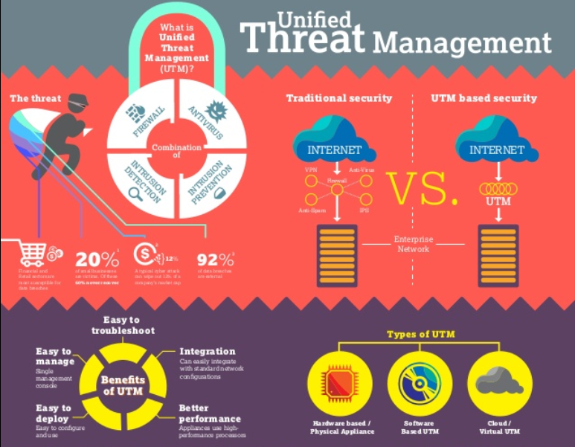
INFORMATION SECURITY SOFTWARE TOOLS

Slide 3
Characteristics of UTM systems
Topics to consider when evaluating UTMs
Benefits of a unified approach to security management

Slide 4
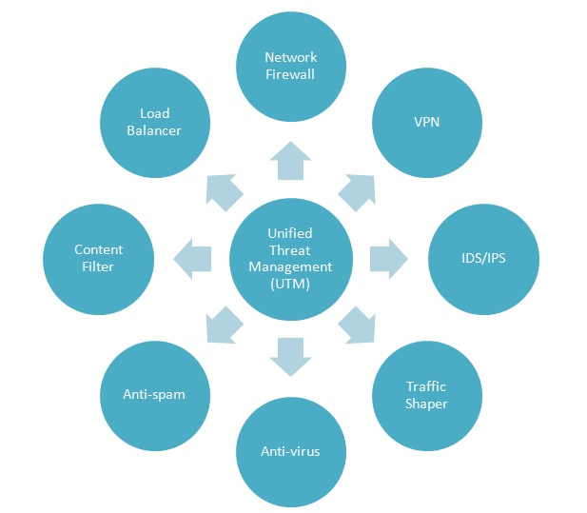
Types of security services provided by UTM systems

Slide 5
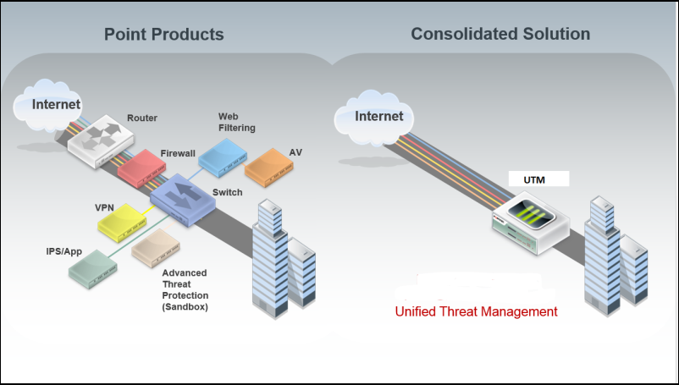

Slide 6
Categories of operational issues of UTM
IPS functionality
Performance
Load balancing
Maintenance operations

Slide 7
Benefits of a unified approach to threat management
consolidated reporting on the state of a network and associated infrastructure
can be deployed in smaller remote locations that would otherwise be held back by a lack of specialized security staff
security controls can be selected as needed
ability to scale to the organization's needs

Slide 8
Summary
UTMs are easy to use
UTMs can be deployed to scale to the changing needs of growing networks, including demands for remote network management
Selecting the proper UTM requires attention to a number of details, such as:
Understanding the security services needed and their locations
UTM performance
Maintenance and management, especially with regard to remote locations

