Slide 1
Control plane requirements for wireless and cellular networks based on SDN
Ministry of Education and Science of Ukraine
State University of Telecommunications
Pavlo Melnikov, Ph.D. student
State University of Telecommunications

Slide 2
Content
1
Introduction
2
SDN Architecture
3
Appliance of SDN in context of wireless and cellular networks
4
System requirements
5
Response Delay analysis
6
Conclussion

Slide 3
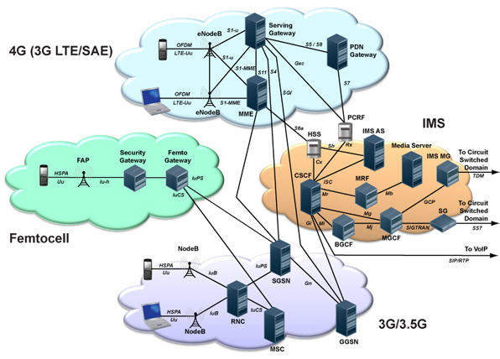
Introduction
Problems with Current Cellular Networks:
Plagued by complex and inflexible architecture
Most data plane related functionality centralized
Control plane too distributed e.g., radio resource allocation
No clear separation between control and data planes
Too complex and inflexible
Notes:
Modern cellular networks

Slide 4
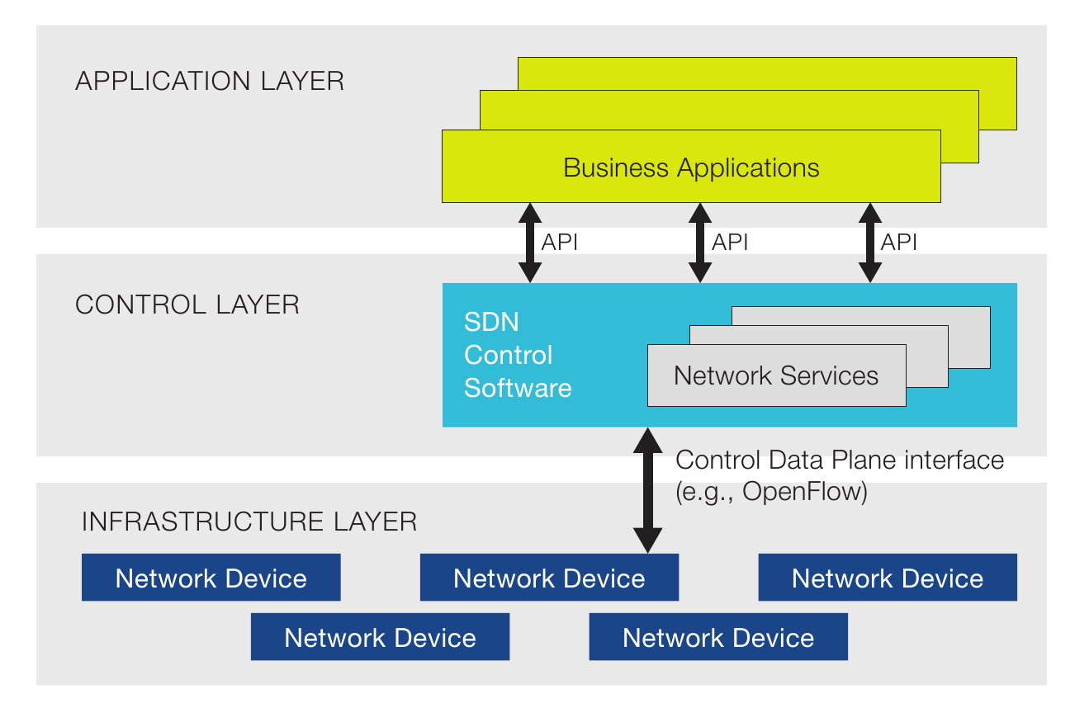
SDN Architecture
Simplifying complexity in network control
Notes:
SDN or software defined networking is the solution which is transforming networking architecture by decoupling data and control plane

Slide 5
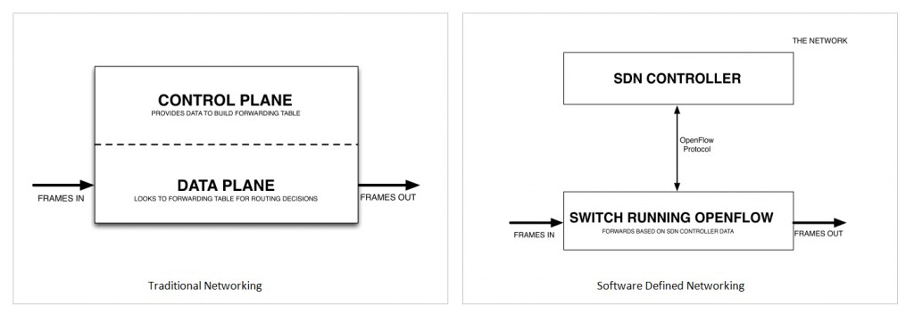
Main terminology of SDN
OpenFlow is the protocol which is used in software defined networks for communicating between SDN operational nodes. Can be used as a control and management protocol
Control Plane is the layer of decisions applying an incoming and outgoing traffic through the network. Control plane packets are processed by the router to update the routing table information
Data Plane is the layer which forwards traffic to the next hop along the path to the selected destination network according to control plane logic

Slide 6
Appliance of SDN in wireless and cellular
networks
Offers a logically centralized control plane - will lead to simpler and effective radio resource management (e.g., inter-cell interference management)
Enables common control protocol across diverse wireless technologies - will ease seamless mobility support within and across technologies (e.g., 4G LTE, 3G UMTS, WiFi)
Allows distributing traffic monitoring at switches deep inside the core network and ease the burden on the packet gateway

Slide 7
SDN and Openflow Use Case
Appliance of SDN in control plane for receiving statistics data from wireless and cellular networks on:
Physical (RSSI, Antenna Gain, Throughput),
Data Link (MAC Addresses, Frame Counters),
Network (IP addresses, subnetworks, Packet Counters),
Transport (active TCP/UDP connections)
Session (Number of active sessions (VoIP))
layers;

Slide 8
Requirements to the system
Requirements to a control plane
Response delay minimization
Statistics gathering on enterprise servers for further analysis by administrator/system
Scaling ability at increasing the number of end devices in a network

Slide 9
Request-Response delay
Parts of a response delay
Notes:
С точки зрения пользователя, время на получение ответа на свои запрос к Web- службс, называемое сквозным временем отклика (end-to-end response /хте), можно разбить на два главных компонента: время сети и время Wcb-сайта (см рис. 3.1). Время сети (network time) - это время, потраченное различными сообщениями на перемещения от пользовательского браузера до Web-сайта. В свою очередь, время сети можно разделить на задержку м время передачи. Задержка [latency) указывает на количество времени в RTT (round-trip time - время на передачу и подтверждение приема), затрачиваемого на обмен сообщениями между клиентским браузером и сайтом. Задержка зависит от природы используемых протоколов передачи данных н. в случае Web-страниц, от дизайна Web-страниц, что более подробно рассматривается в этой главе. Время передачи (transmission time) — это время, необходимое для передачи всех байт, которыми обмениваются браузер и Web-сайт Время передачи зависит от пропускной способности самого медленного соединении в цепочке между браузером и сайтом.
Запрос на получение Web-службы может посетить один или большее количество Web-сайтов. Время, затрачиваемое запросом на Web-сайтс, можно разложить на два компонента (см. рис. 3.1): время обслуживания и время нахождения в очереди. Время обслуживания (service time) - это промежуток времени, в течение которого запрос обслуживается такими ресурсами, как процессоры, диски, сегменты локальной сети или линии связи

Slide 10
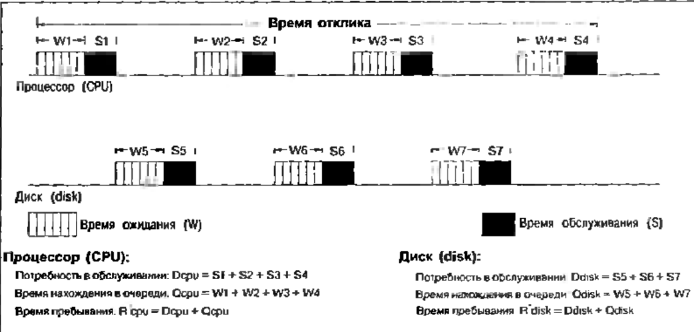
Response delay minimization
To minimize response delay, we need to define bandwidth server and router delay

Slide 11
Response delay minimization
The goal is to define Bandwidth-delay
minimization which is introduced by a TCP Protocol
Bandwidth x Delay = BDP

Slide 12
Server delay
The goal is to define delay minimization introduced by a RAID5 disc array which is located on a server.
After counting the number of read operations, which are made by read write requests, we can get an equation for an input intensity of disc requests
Input intensity for request of one server disc

Slide 13
Network delay
The goal is to define delay minimization which is introduced by a border router.
The time nedded for router for datagram processing is called router delay and its value usually is represented by router manufacturer. The general time of message servicing on a router:
, where
Rts = Nd x Tdr
Rts – Router service time
Nd – number of datagrams
Tdr – Router delay (latency)

Slide 14
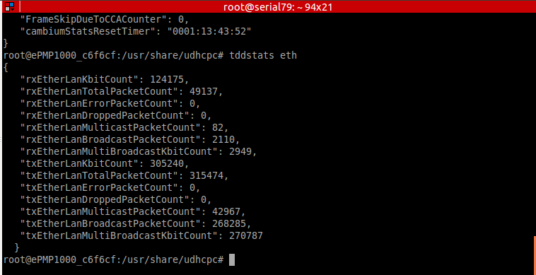
Use Case: network equipment statistics request using Openflow protocol
Request
Response
switch(reqinfo->mode)
{
case MODE_GET:
pthread_mutex_lock(&cambstats_mutex);
switch(reginfo->handlerName[0])
{
case '0': // 0 force_upd
camb_stats_schedule_update(STATS_UPD_ATH_ETH);
break;
case '1': // 1 eth_rx_bytes
param_64 = eth0_stats_res.rx_bytes >> 7; break; /*convert to KBit 8/1024 /
case '2': // 2 eth_rx_packets
param_64 = eth0_stats_res.rx_packets; break;
case '3': // 3 eth_rx_errors
param_64 = eth0_stats_res.rx_errors; break;
case '4': // 4 eth_rx_drops
param_64 = eth0_stats_res.rx_drops; break;
case '5': // 5 eth_rx_multicast
param_64 = eth0_stats_res.rx_multicast; break;
case '6': // 6 eth_rx_broadcast
param_64 = eth0_stats_res.rx_broadcast; break;
case '7': // 7 eth_tx_bytes
param_64 = eth0_stats_res.tx_bytes >> 7; break; /*convert to KBit 8/1024 /
case '8': // 8 eth_tx_packets
param_64 = eth0_stats_res.tx_packets; break;
case '9': // 9 eth_tx_errors
param_64 = eth0_stats_res.tx_errors; break;
case 'A': // A eth_tx_drops
param_64 = eth0_stats_res.tx_drops; break;
case 'B': // B eth_tx_multicast
param_64 = eth0_stats_res.tx_multicast; break;
}

Slide 15
Conclussion
Using SDN control plane for gathering and analyzing statistics data of terminal equipment, calculating the intensity of read requests disk arrays, reducing the request-response latency is beneficial for using in wireless and cellular networks.
15

Slide 16
Thank You!

