Slide 1
Accelerate Ukraine National Digital Economy
Catch Up for Integration with EU Digital Single Market

Slide 2
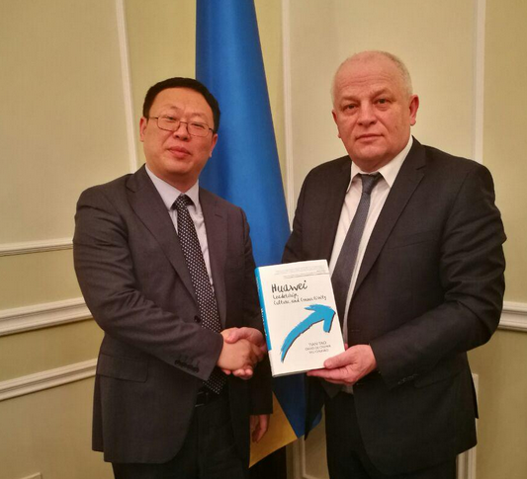
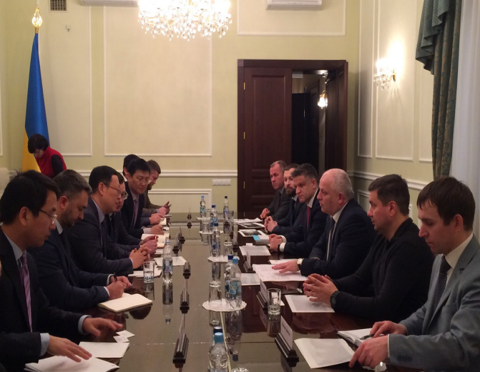
Huawei & Cabinet Conference on Ukraine ICT--- 2017.2.21
Ukraine Can Capture Digital Potential by invest on ICT Infrastructure and System
Mobile Telecom Can Accelerate Ukraine NBN ICT Infrastructure and Internet Connection
Huawei Willing Contribute Ukraine Digitalization
Key
Points
Ukraine MBB & Spectrum Strategy Consulting
ICT Regulation & Policy Consulting
Remain
Tasks
NBN: National Broad Band Network
MBB: Mobile Broad Band
FBB: Fixed Broad Band Network
Notes:
建言：充分利用频谱资源 促进经济高速增长
据统计，移动通信的渗透率每提高10%，对GDP的拉动作用将达到1.1%。要充分认识信息化在建设创新型社会和经济发展中的先导性和基础性作用以及频率资源作为建设“无所不在”网络的基础性作用。
要像关注土地资源一样充分关注频谱资源的闲置问题，尽快规划释放数字红利频谱，并将其作为国家宽带战略配套政策的一部分。在移动宽带急剧发展的今天，要充分认识频谱资源的闲置与土地资源的闲置一样，会产生昂贵的经济发展机会成本。尽快启动农村地区的无线宽带广覆盖以及远程教育、远程医疗等民生应用，以缩小城乡数字鸿沟。

Slide 3
3G MBB Foundation Network Promote 4G Development
2G:
3G:
4G:
Voice Service
Basic Personal Internet Service
Mobile Internet to Industry
200kbps
21-42Mbps
4G
100-1000Mbps
2017--?
2G
3G
4G
3G
3G
13 Years
2G
6 Years
2015-2017
2G
2G
1993-2014
1992 --2005
2005 --2011
2011 --
European Countries Development History Reference
Ukraine Status
4G Greatly Promote Ukraine Society & Economy Development, But Need Mature 3G
3G: MBB Foundation Network
More 3G MBB Coverage + Penetration , Cultivate Society Mobile Internet Behavior
Ready Environment for the Coming 4G Booming Usage
Ukraine Challenges
Ukraine 4G Should Come In Short Time to Catch Global Process—(on going)
3G MBB Foundation Network Not Ready

Slide 4
Turkey: Rebuild 3G After 1 Year 4.5G Development
3G–UMTS 900 Co-development With 4.5G in Turkey
4.5G License
4G@LTE 800Mhz
3G-UMTS900Mhz
4G@LTE 1800Mhz
3G@U2100
4G@L2600Mhz
2015/8
2016
2017
2018
2015.08: 4.5G Licensing, 900/1800/2100 Bands Technology Neutrality
2015.10: Start LTE 2600M/800M/1800M construction, 3G construction stopped,
2016.04, 4G Commercialization, Till 2016.12 4G Subscribers grow quickly;
2017.01 -- 2017.03 : 4G Subscribers growth slowly , operators re-build 3G-UMTS900M

Slide 5
Country-Wide 3G Realize UA Universal Internet Connection
Now
Next Steps
3G: Partial MBB Network
3G: MBB Foundation Network
Cover Ukraine Cities Urban and Towns
Cover 65% Population and 18% Territory
Indoor 3G Coverage is not feel good
Rest 40% Ukraine Residents lives in Rural
Enhance Indoor Coverage
Additional 70% Ukraine Territory
Urban
Suburban
Town
Rural
Road
Ukraine Status
98%
88%
3G
65%
46% 3G MBB Penetration
2G
(2017/3)
18%
56M
2G Subs
19.8M
3G Subs
42.7M
Population
Geographic
Coverage
Population coverage
Geographic
Coverage
Population coverage

Slide 6
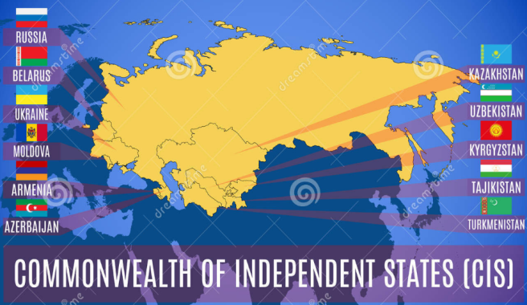
Government Can Defragment 900Mhz Band Through Reallocation
Distribution
CIS Status
Except UA , All CIS Countries 900Mhz (3G/4G) Technology Neutrality
Together with 4G Tender Processing
UA Government Can Solve 900Mhz Band Challenges
UA Situation
Global Status
High Spectrum Fragmentation
U900 Require 5Mhz Continue Spectrum
Spectrum Waste and Inefficient
Technology Neutrality not allowed
3G/4G Networks prohibited
120+ Countries 900Mhz Technology Neutrality
Total 190+ UMTS 900 Networks;
All EU Countries 900Mhz Technology Neutrality
Large mature UMTS900 user devices ecosystem.
96% 3G device support U900

Slide 7
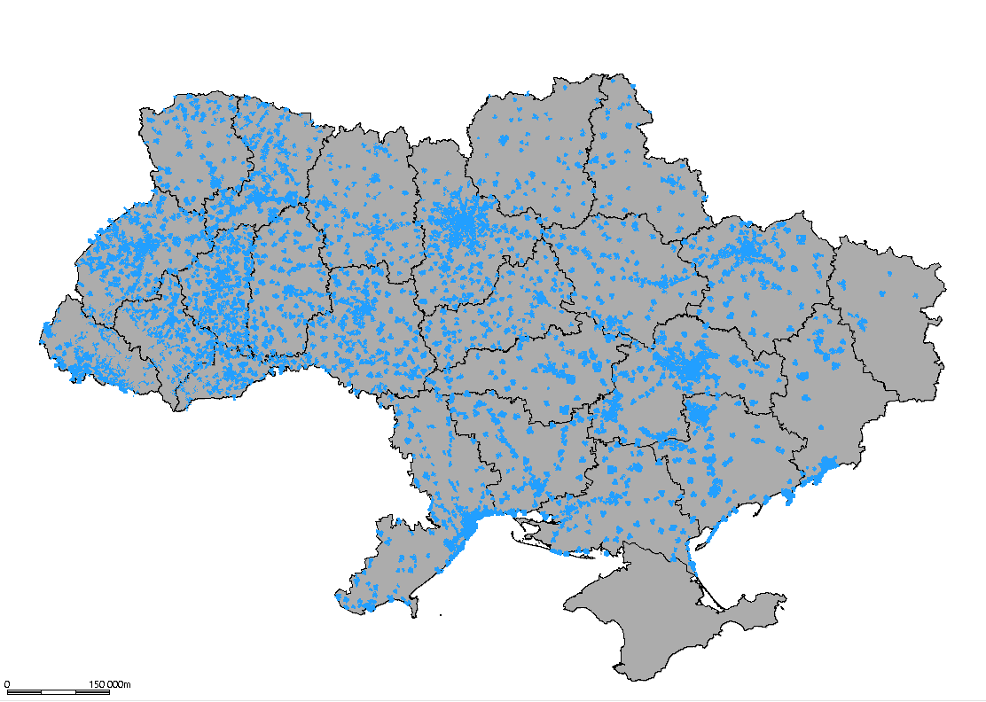
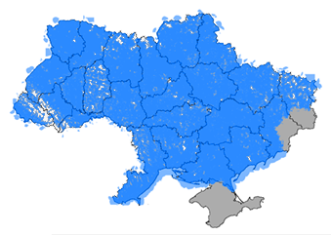
UMTS@900: Best Option for Nation/Residents/Mobile Operator
3G-2100 Coverage (Now)
3G-900/2100 Coverage (After)
2~3 Month
3 Mbit/s National
Mobile Internet
+ 15 Mln. Population
+ 3000 Settlements
UA Government
Mobile Operators
Mobile Vendors
Promote Economy & Society Development
Compensate 3G MBB device by Saving 3G Sites Investment
3G/4G Market growth
Wish
Ready
4G License Auction and Spectrum Allocation
SRAN GSM 900 BTS Hardware Ready for Active UMTS900
GU 5Mhz Solution save 3G-U900M spectrum
Require
900Mhz Technology Neutrality
UMTS 900Mhz License
Re-allocate the 900Mhz Spectrum(Has Feasible way )
GU900Mhz Reframing Engineering
Notes:
Finally, slide, which expresses the main idea that Kyivstar was trying to convey today to journalists (and through them - the public): the one with customers most of all (we will not point the finger, but it Kyivstar) should get more frequency resources than those who have fewer subscribers. The analogy with paths for swimmers and swimming pool looks very successful, but the chances that the entire frequency range will be divided in some other way than fifty-fifty, almost none.Otherwise, we will get the same violation of equal rights for all players in the market, for which the fighting, trying to approach the level of the civilized world. Yes, and no one will carry out refarming of frequencies each time, as the distribution of subscribers of operators to change.

Slide 8
Country-Wide 3G-U900 MBB Bring Huge Benefits for All
3G UMTS 900M Save Investments & Time for 3G Wide and Indoor Coverage
Develop more 3G User to Short the time for Return of 3G Investment (ROI)
3G Business growth Balance Finance Conditions with 4G Tender and Launch Cost
3G MBB Foundation Network will Promote 4G Business Development
Make continue investment on 4G and Short the time for ROI
Operator
Benefits
Eliminate Big Gap of MBB Access to Internet between Ukraine and EU Countries
Accelerate Ukraine Integration with EU, Boost EU Financing
Eliminate Big Gap between Cities and Rural areas in MBB high-speed Internet
Internet Drives Rural Economy and Society Growth
Win more citizens support for efforts on their Internet Connection
Government
Benefits
- All Rural Area Even Very Poor Villages can Connect Internet
“E-Education” “E-Healthcare” “E-Government” Services can be Available in Rural
All Nation & State Main Roads, Railways Mobile Internet covered, can connect Internet
Indoor MBB signal be enhanced , Mobile Internet experience become better
Resident
Benefits
(Economy & Society Benefit Brought by Country-Wide 3G MBB is Even Bigger than EU-VISA free)

Slide 9
Ukraine Universal Connection Service Project Proposals
1. Government lead Operators Reallocate the 900Mhz Spectrum
Lifecell and Intertelecom exchange the CDMA 850 2.5Mhz frequency band; Permit Lifecell 900Mhz to be 3.7 +2.5= 6.2Mhz
Kyivstar as the donor to return 3.5Mhz GSM 900 spectrum, VDF & Lifecell purchase and compensate to Kyivstar
PGSM 900M Hz | Kyivstar | Vodafone | LifeCell | Guard Ch. | Military
Before | 12,5 | 5,2 | 3,7 | 1,9 | 3,4
After | 8,9 | 7,0 | 7,0 | 0,4 | 3,4
Delta, MHz | - 3,6 | + 1.8 | + 3,3 | - 1,5 | 0
All operators has 5Mhz continue spectrum
High spectrum Efficiency
Technology Neutrality can be allowed
3G/4G Technology on 900 be enabled
2. Government Authorize Technology Neutrality for the Holding 900Mhz Spectrum
licensing for 3G @900Mhz is the key to realize Ukraine government universal internet connection service project
licensing for 3G @900Mhz require operators’ obligation to realize 3G national(Country-wide) coverage within 1 year;
licensing for 3G @900Mhz spectrum should not make the same as 4G@1800Mhz licensing auction tender
licensing for 3G @900Mhz with reasonable one time charges according to quantity of spectrum holdings (Per Mhz)
3. Government Provide MBB Devices with Civil Services for Rural Communities
Government take use 3G @900Mhz licensing budget provide entry-level (<50USD) smart phone or Wi-Fi router to poor rural communities where never has 3G mobile internet connection
Each family live in poor rural communities can be presented one smart phone integrate with Ukraine E-Government applications
4. Government Provide Telemedicine and E-education for Rural Communities
UA government cooperate with UNDP, World bank, Mobiles Operators and Vendors to provide universal civil services
Economy & Society Benefit from Universal Telecom Service Project is Even Bigger than EU-VISA free

Slide 10
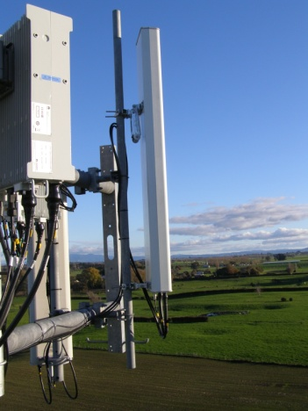
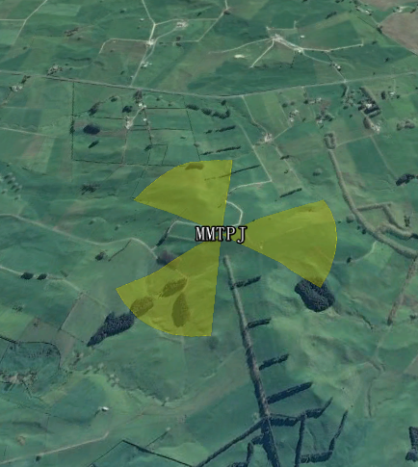
Germany : Lower Band MBB Promote NBN Strategy
BB
Nationwide
2 Mbit/s
75%
households
50 Mbit/s
100%
households
50 Mbit/s
2010
2014
2018
Award LTE 800 2010 with rural 4G coverage Obligation: 90% Rural 4G Coverage by 2016
Digital Divide 800Mhz
Digital Divide 700Mhz
Award LTE 700Mhz 2015;
Make 4.5G Services Specially in Rural area to reach target of 2018
Award LTE 800 at 2010 Specially Support National Internet Penetration (Rural + Villages)
Technology Neutrality : 900Mhz@ 2011, 1800Mhz @ 2012 ; Enable U900 /L1800;
Notes:
2009年2月，在德国总理办公室举行的宽带产业峰会上，德国政府与电信业界达成一致，双方将共同致力于推动宽带在德国的普及。这些目标包括：到2010年，将德国家庭宽带覆盖率提高到100%；到2014年，将速率达50Mbps的宽带覆盖到德国75%的家庭；2018年再将这一比例提高到100%。与会各方就实现上述目标所采取的主要措施也达成了协议，其中包括利用“数字红利”频谱。德国于2010年4月分别对700MHz、1800MHz、2GHz核心频段、2.6GHz频段进行了频谱拍卖，获得了共计43.8亿欧元的收入;
欧盟国家纷纷释放“数字红利”频谱;
欧盟频率管制政策的改革将符合两个目标：其一，对频谱进行自由化使用，这意味着技术和业务的中立性；其二，加大频谱交易和建立频谱市场。在2009年上半年欧盟出台一个雄心勃勃的行动计划，使得欧洲能够尽快从“数字红利”（790MHz~862MHz频段）中获得利益。欧盟要求成员国自2012年起全部实现从模拟电视向数字电视的转换，并释放由此所产生的“数字红利”频段，刺激无线业务发展。2012年3月欧洲议会又通过了一项为期5年的无线电频谱政策计划，其中要求在2013年1月1日前，所有欧盟成员国（除非已在该日期之前获得个别豁免）应授权将700MHz频段用于无线宽带通信。欧盟委员会估计，如果2015年之前能够统一欧盟区“数字红利”频段的使用，则此后15年将为欧盟带来200亿~500亿欧元的经济利益。
英国政府于2010年7月宣布，计划在2011年年底进行业界期盼已久的700MHz频谱的拍卖，并将拍卖带来的数十亿英镑的收益用于偿还国家债务。英国政府作出频谱拍卖的决定，一方面是由于近来英国模拟电视向数字电视的切换释放了大量宝贵的频谱资源，同时也考虑到由于iPhone等智能手机激增的带动，移动数据使用量急剧上升。英国预测约有112MHz的电视频段被释放。 法国2008年10月公布了“2012数字法国”计划，法国政府承诺将广播电视模/数转换所节省的部分频谱分配给宽带移动服务使用。法国电信管理部门对“数字红利”进行了深入研究，其结论是将空闲出的频谱分配一部分给移动宽带服务将比仅仅留给数字电视服务会产生更多的经济价值。如果通信业和广电业能够分享“数字红利”，在2012年到2024年间，将为法国经济多带来250亿欧元的利益。另外，将频谱分配给移动宽带将保证法国政府在2012年实现100%的法国居民都能通过宽带连接到互联网的目标。2010年12月，法国电信监管机构Arcep告知进行LTE试验的移动网络运营商，在2011年11月决定700MHz频谱的中标方。
欧盟其他国家，如西班牙在2011年8月举行的最新一轮LTE频谱拍卖中，拍卖的是位于700MHz、900MHz和2.6GHz频段上的58个片区的频谱，共获得超过16.5亿欧元的收益。瑞典政府在2011年2月拍卖了原来用于广电的700M频段，重新规划900M频段，用于移动通信的频谱将达到1047MHz。另外，芬兰、卢森堡、荷兰、比利时、奥地利、丹麦、马耳他、斯洛文尼亚等国都已完成电视的数字化转换，释放700MHz频谱“数字红利”皆在计划与进行中。

Slide 11
China: MBB Support Country-Wide NBN 2020 Target
Fiber BB Internet : 100% City &Town , 90% Rural Reach
Speed: City 50Mbps, Rural 15 Mbps
4G MBB : Nationwide 100% Reach
4GMBB Penetration: Cities 100% ; Rural Villages 90% %
“2020, 4G will reach all rural villages , solve “Last Mile” problem，let all residents to access Internet”
---MR. Xi Jin Ping, Report on the World Internet Conference 2015
Government Push on Rural MBB Internet “Last Mile”
Internet Drives Rural Economy and Society Growth
1. Rural E-Commerce
2. Rural Logistics Industry
3. Modern Agriculture Production & Service
4. Rural Education/Health care Public Services
5. Rural Entertainment Service + Propagation
Technology Neutrality : 900Mhz@ 2015, 1800Mhz @ 2015 ; Enable UL900/L1800
Notes:
在习近平“五点主张”之中，第一就是加快全球网络基础设施建设，促进互联互通。预计到2020年，中国宽带网络将基本覆盖所有农村，打通网络基础设施“最后一公里”，让更多人用上互联网。还有“打造网上文化交流共享平台，促进交流互鉴”，以及“推动网络经济创新发展，促进共同繁荣”等等。 这样一系列的战略计划与行动布局，透露了未来农村发展的五大商机。 一是农村电商。农村市场将会是中国未来几年互联网经济里面最大的一块蛋糕，也是最后的一块蛋糕。当年家电下乡、汽车下乡，还有紧接着的农民工市民化，都是把目标瞄准农村、农民和农业，这说明这个市场还是非常有潜力的。如果在宽带网络全部打通之后，相信农村电商这块蛋糕会越来越丰富。农村淘宝的抢先布局，正是看中了这一趋势。 二是农村物流。互联网的发展，尤其是电子商务的发展，带动了物流业的飞跃。农村由于地广人稀，交通相对落后，过去的物流业在农村发展并不完善。城市的商品难以迅速到达农村，农村的产品也难以迅速销往各个地方。 三是现代农业产品与服务业发展。农业一直是我们的短板，产品、服务，发展面临诸多困境，也有很大潜力。如果能有一个好的平台，既让老百姓消费、购物很方便，又能让农村好的东西可以销售到城市去。这不仅让农民大大增收，更是会促进现代农业的发展。一批好的农业品牌将会诞生，一些有品质的乡村旅游等服务项目将会得以推广。有了互联网平台的推广，相信会催生现代农业的飞速发展。 四是农村文化娱乐传播。时下，农村文化体育娱乐资源明显短缺，人们除了电视、麻将、广场舞等之外，一些更深更广更先进的文化形式或理念，还在广大农村相当缺乏。此次大会习近平提出“我们愿同各国一道，发挥互联网传播平台优势，让各国人民了解中华优秀文化，让中国人民了解各国优秀文化，共同推动网络文化繁荣发展。”这个文化共享平台，可以借助互联网之势，迅速将城市先进的东西传播到农村，从而深刻影响和改变着农村的文化现状。这也给广大的文化传播公司提供了机会，如何瞄准农村、农民、农业，真正制作出最优秀、最接地气的作品。 五是农村公共服务拓展。农村的发展，就要逐步缩小与城市的差距，特别是在教育、医疗卫生等基本公共服务项目方面，如何最大限度地利用互联网，真正做到共享资源，让最优质的教育、医疗资源送到农村，是大有空间的。比如网络培训、网络教育，甚至于生活便利的服务。包括门诊，医院预约，政府公共事务的预约，都是未来的发展方向。尤其是面对农村文化素质偏低的现状，教育培训恐怕就更有市场了。 农业强则中国强，农村安则天下安，农民富则国家富。互联网的这场布局，显然具有着极强的战略视野，不仅推动脱贫攻坚，更是推动全面小康。
到2017年底的主要目标是：
网络能力上，全国所有地级以上城区家庭都将具备百兆光纤接入能力，80%以上的行政村要实现光纤到村，4G网络全面覆盖城市和乡村；
宽带速率上，直辖市和省会城市等主要城市宽带平均接入速率要达到30Mbps（基本达到2015年发达国家的平均水平），其它城市宽带平均接入速率达到20Mbps；
普及程度上，移动宽带人口普及率要达到中等发达国家水平（目前75%左右）；
资费水平上，手机流量和固定宽带平均资费水平将大幅下降。
总的来看，建设“高速畅通，覆盖城乡，质优价廉，服务便捷”的宽带网络，既有利于拉动有效投资、壮大信息消费，支撑“互联网+”行动计划的实施，促进工业化、信息化、新型城镇化和农村现代化的融合发展；又有利于降低创业成本、为打造大众创业、万众创新和增加公共产品、公共服务“双引擎”增添新动力。

Slide 12
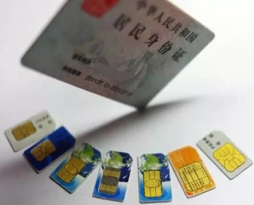
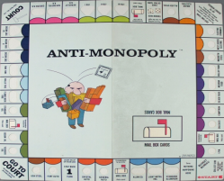
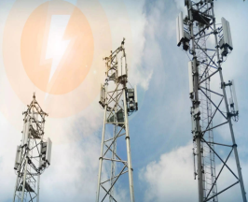
Key Actions China Government Promote National Digitalization
IT Data Center
IT Cloud
MBB
FBB
Preserve the Efficiency/Competitive
MNP give real freedom to subscribers
Register SIM card with ID
Limit abuses of market power
3G/4G License with National
Coverage Obligations
Large Scale National BB Network +DC
3G/4G MBB National Coverage as fundamental Infrastructure
CMCC 1.5 Million Base station In china, 99% 2G/3G population coverage, 95%+ 4G Population coverage
Regulation and Policy
New ICT Infrastructure
China
National Digitalization
Financial
Investment
Start-ups
Society Industry Convergence
Grand budget for 3G/4G Infrastructure
800/900/1800Mhz Golden Spectrum Technology Neutrality
Reframing for very short time 3G/4G Open
Promote national coverage construction
Start-Up/ Cultivate Nation Environment
Economy Informatization —E-Commerce
Public Service(E-Government/Education)
Society and Industry Informatization, all go On Line and IOT (Internet of Things)

Slide 13
Thank You !
Welcome One Open Discussion !

Slide 14
900Mhz Band Defragmentation and Re-Allocation Scheme
5M GSM+UMTS
5M GSM+UMTS
5M GSM+UMTS
Guard
Band from
CDMA
5M GSM+UMTS
PGSM 900M Hz | Kyivstar | Vodafone | LifeCell | Guard Ch. | Military
Before | 12,5 | 5,2 | 3,8 + 2.5(CDMA) | 1,9 | 3,4
After | 10,0 | 7,0 | 7,0 | 0,4 | 3,4
Delta, MHz | - 2.5 | + 1.8 | + 0.7 | - 1.5 | 0
All operators has 5Mhz continue spectrum
High spectrum Efficiency
Technology Neutrality can be allowed
3G/4G Technology on 900 be enabled

Slide 15
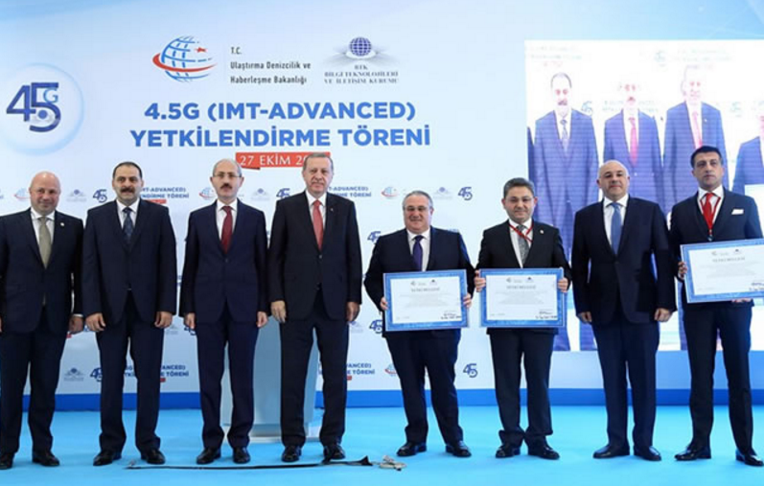
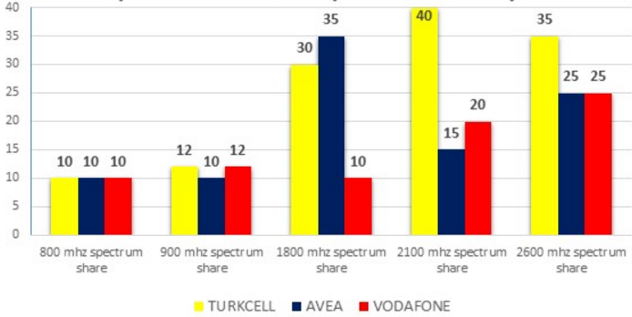
Turkey : 4.5G Licensing Tender for Spectrum Allocation
Frequency |  | Band width(MHz) | Winner Operator
800 MHz | A1 | 2x10 | Vodafone
 | A2 | 2x10 | Turkey Telecom
 | A3 | 2x10 | Turkcell
900 MHz | B1 | 2x7,6 | Turkey Telecom
 | B2 | 2x1,4 | Vodafone
 | B3 | 2x1,4 | Turkcell
1800 MHz | C1 | 2x29,8 | Turkcell
 | C2 | 2x20 | Turkey Telecom
 | C3 | 2x10 | Vodafone
2100 MHz | D1 | 2x5 FDD | Turkcell
 | D2 | 2x5 FDD | Turkcell
 | D3 | 1x10 TDD | Turkcell
2600 MHz FDD | E1 | 2x25 | Turkcell
 | E2 | 2x15 | Vodafone
 | E3 | 2x10 | Turkey Telecom
 | E4 | 2x10 | NA
2600 MHz TDD | F1 | 1x15 | Turkey Telecom
 | F2 | 1x10 | Vodafone
 | F3 | 1x10 | Turkcell
 | F4 | 1x5 | NA
*4.5G License Tender in Aug, 2015
*License be valid for 15 years
LTE License Auction Tender for at 800-900-1800-2100-2600 spectrums bands ;
All spectrums bands (900/1800/2100) give Technology Neutrality Permission (2G/3G/4G);
Licensing provide frequency resource equalization and balance for healthy competition;
Areas with less than 10.000 population, Network Sharing Model can be used to save the costs;
800 MHz spectrum shared equally among 3 operators, TV at 800 MHz shifted to 700 MHz;
900 and 1800 will set an upper limit according to actual status of the 3 2G/3G operators;
within 6 years 90%, 8 years 95% of population 4.5G Coverage Obligation requested;
Regarding competition, MNP in Turkey given.
2600 Mhz TDD can be available for newcomer and there will be obligations like others;
Notes:
*Totally 20 package will be offered.
• for 800 MHz; 2x30 MHz FDD band (791 – 821 MHz (DL)/832 – 862 MHz (UL)) will be shared as 3 package of 2x10 MHz FDD,
• for 900 MHz ; 2x10,4 MHz FDD band (880,1 – 890,1 MHz (UL)/925,1 – 935,1 MHz (DL) and guard bands (901,1-901,3 MHz (UL)/946,1-946,3 MHz (DL) & ( 912,3-912,5 MHz (UL)/957,3-957,5 MHz (DL) arası)) will be shared 2 package of 2x1,4 MHz and 1 package of 2x7,6 MHz FDD
• for 1800 MHz ; 2x59,8 MHz FDD band (1725,1 – 1784,9 MHz (UL)/1820,1 – 1879,9 MHz (DL)) will be shared as 1 package of 2x29,8 and 1 package of 2x20 and 1 packed of 2x10 MHz FDD
• for 2100 MHz , 2x10 MHz FDD band (1970 – 1980 MHz (UL)/2160 – 2170 MHz (DL)) and 1x10 MHz TDD band (2015-2025 MHz) will be shared as 2 package of 2x5 MHz FDD and 1 package of 1x10 MHz TDD ,
• for 2600 MHz ; 2x60 MHz FDD band (2500 – 2560 MHz (UL)/2620 – 2680 MHz (DL)) will be shared as 1 package of 2x25, 2x15, 2x10 ve 2x10 MHz FDD and 1x40 MHz TDD band , (2570 – 2610 MHz) will be shared as 1 package of 1x15, 1x10, 1x10, 1x5 MHz TDD
*Existing GSM and UMTS operators could bid all packages except E4 package. New operators can request E4,F1,F2,F3,F4. Only operators who get FDD 2600MHZ packages can bid for TDD 2600MHz packages.
* at the end for 800MHz,900Mhz,1800MHz and 2100 MHZ, at most 3 operators with existing GSM&UMTS license will be licensed. And for 2600MHz, at most 4 operators ( involving 3 operators with existing GSM&UMTS license) will be licensed.
*Bidding will be on 26.05.2015 Tuesday 10.30 A.M at Yeşilırmak Sok. No:16 06430 Demirtepe/Ankara” BTK main building. And offers will be given closed envelope and continue open offers.
*License will be valid until 30/04/2029.
* Bidder be coorperation with at least higher than 50 Million TL capital and will be able to do device sale, operation etc works in this scope.
* except stock exchage share, if biddger company has cooperation with another company or control over some other company, these other companies can not join bidding.event they join, if their relations are found out, license will not be given and bonds will not be given back.

