Slide 2
5G in Albania

Slide 3
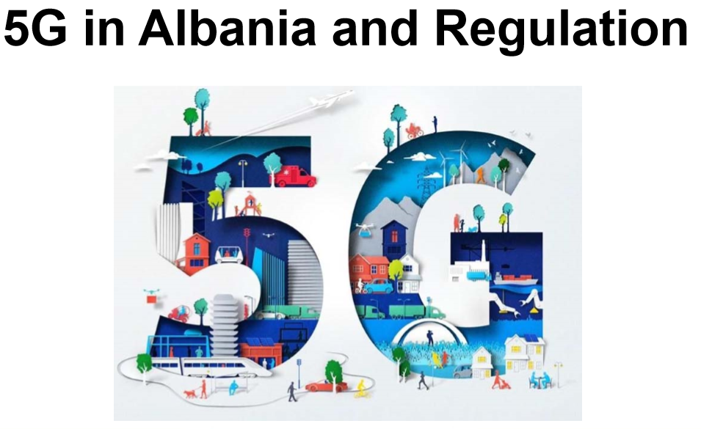

Slide 4
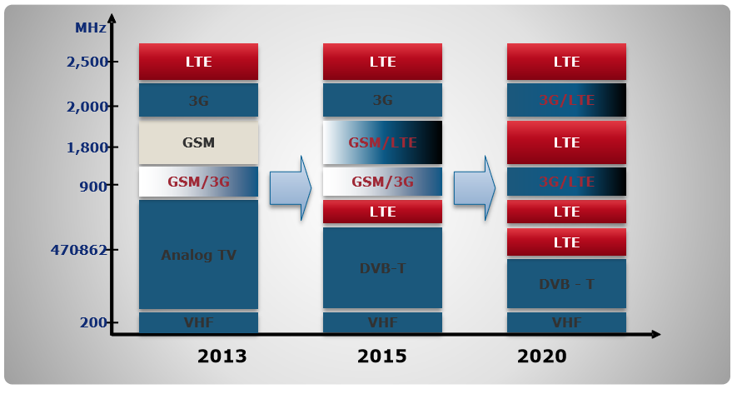
Future spectrum use
Authorizations and fitting models for using suitable 5G frequency bands
Spectrum-sharing models to use the scarce frequency resource
Fair competition

Slide 5
Currently there are three mobile networks operators in the market
The mobile market is well developed with good coverage in 3G/ 4G which are offered at above 70% penetration from all mobile market players
Mobile broadband is provided based on HSPA/HSPA+ was introduced not so far ago in Albania only in 2010, whilst 4G/LTE was just presented on September 2015

Slide 6
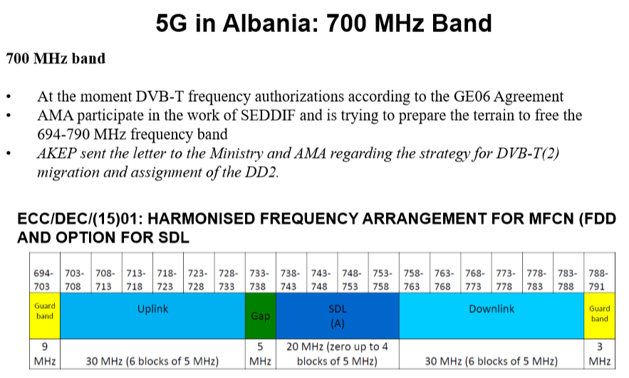

Slide 7
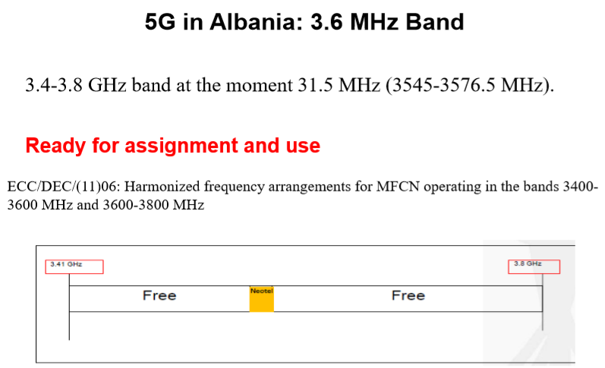

Slide 8
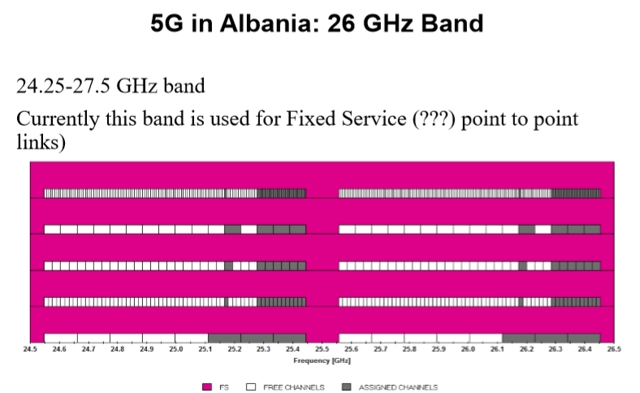

Slide 9
2019 AKEP strategy
Focusing on consumer protection remains of paramount importance to us;
Spurring the use of spectrum in order to achieve a high social economic development;
Guaranteeing sufficient spectrum for all services as we have demonstrated in our last endeavor with 800 MHz allocation
Timely finish the SEDDIF work and free the 700 MHz band;
Update of the National Broadband Plan with implementation strands in relation to 5G

Slide 10
2019 AKEP strategy towards 5G
AKEP is ensuring appropriate frequency spectrum as a fundamental resource for 5G applications.
AKEP’s strategy for implementing new technical criteria for the introduction of 5G is under elaboration and the rules for the transition period are to be developed.
AKEP plans to carry out another tender procedure for the remaining 800 MHz spectrum (DD1) blocks for broadband mobile services which are also a National Priority as devised by our Parliaments Strategy Paper for 2019.
AKEP will cooperate closely with the MEI and the AMA (Audiovisual Media Authority) in developing strategy and concrete proposals for the necessary future use of the 700 MHz band
AKEP has collaborated with the National Cyber Security Agency (ALCIRT) in relation to identifying possible cyber threats and alerting operators in a timely manner to take immediate action.

Slide 11
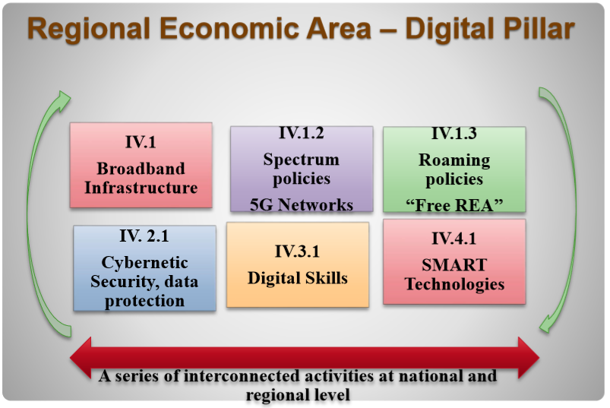
What should we do about 5G Security?

Slide 12
Thank you!

