Slide 1
Modern Challenges and Threats to Digital Transformation
Vitalii Savchenko
State University of Telecommunications

Slide 2
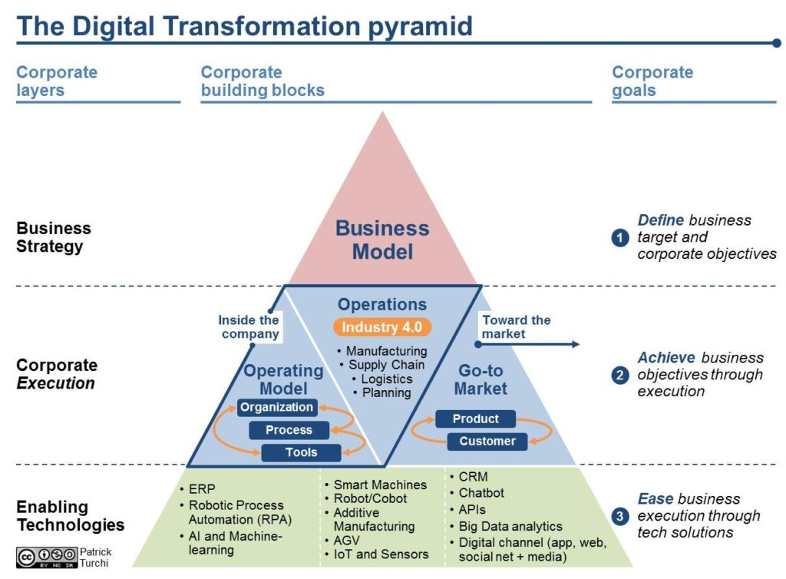
Digital Transformation

Slide 3
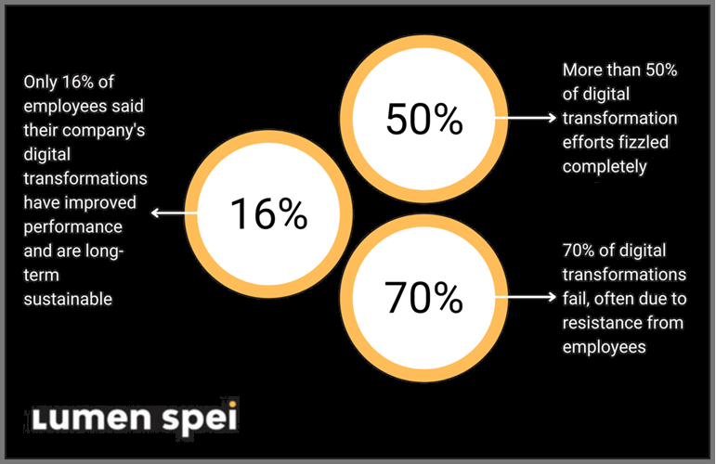
Why is Digital Transformation Difficult?
3
Kyiv, 28 December 2022

Slide 4
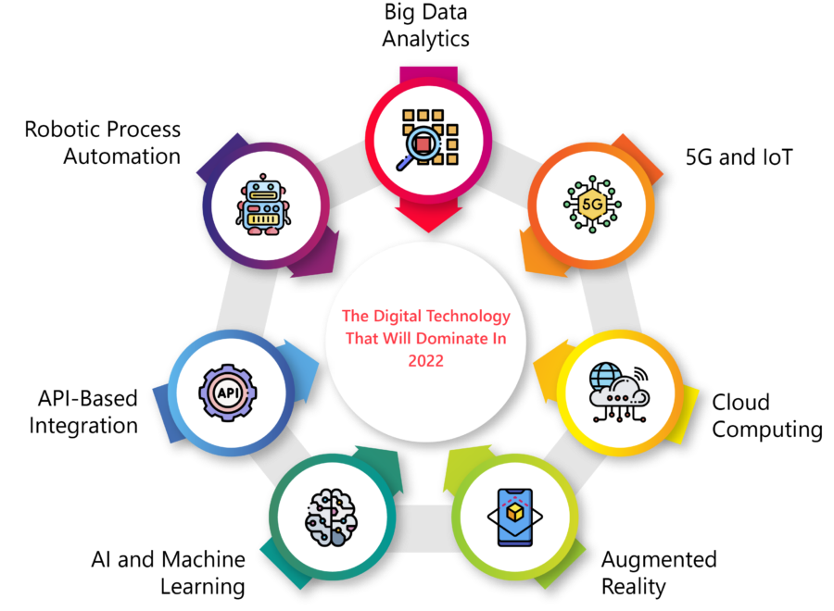
Complex Software and New Technologies
4
Kyiv, 28 December 2022

Slide 5
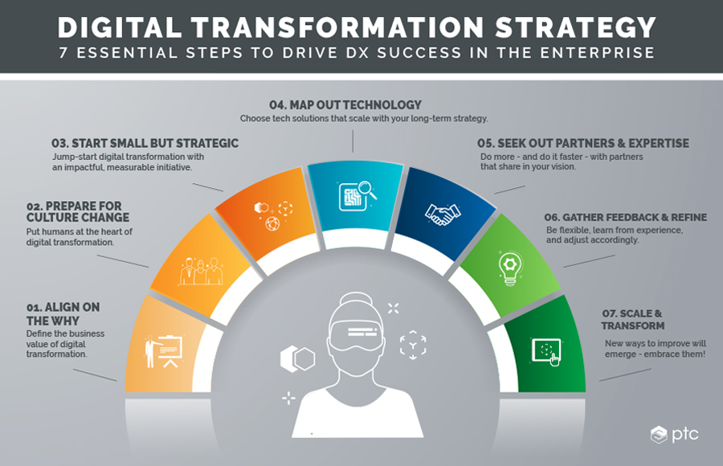
Lack of Digital Transformation Strategy
6

Slide 6
Lack of Proper IT Skills
6

Slide 7
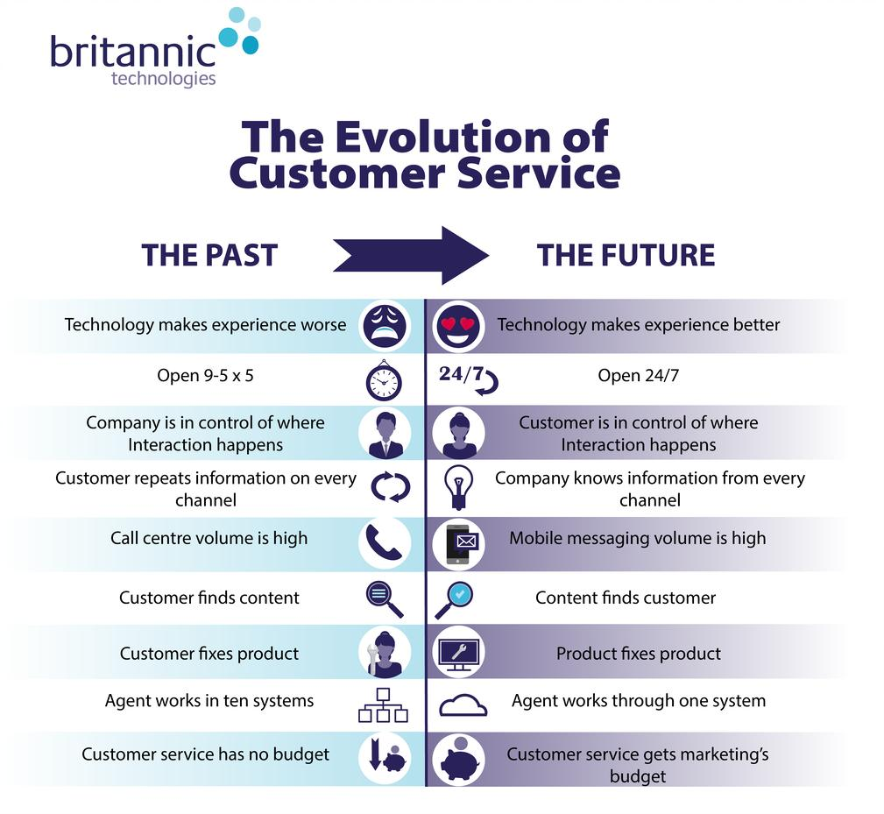
Evolution of Customer Needs
7

Slide 8
Inappropriate Budget
8

Slide 9
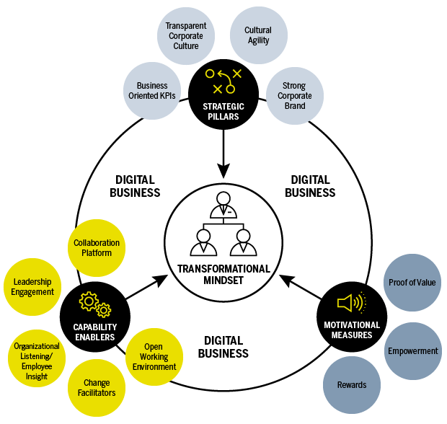
Mindset Shift
9

Slide 10
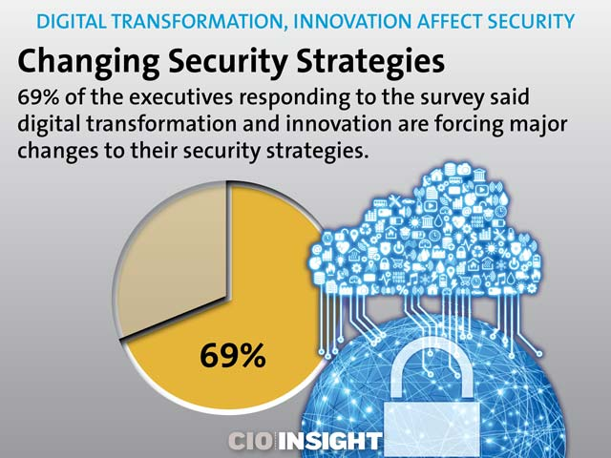
Security
10

Slide 11
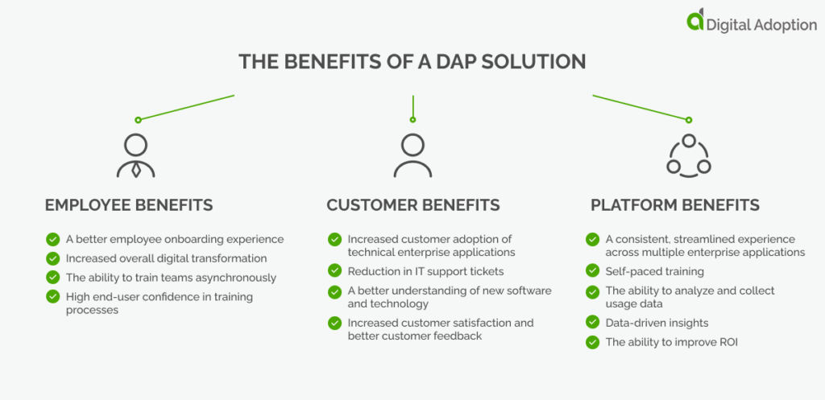
Overcoming the Challenges and Threats
11
1 - Invest in a Digital Adoption Platform

Slide 12
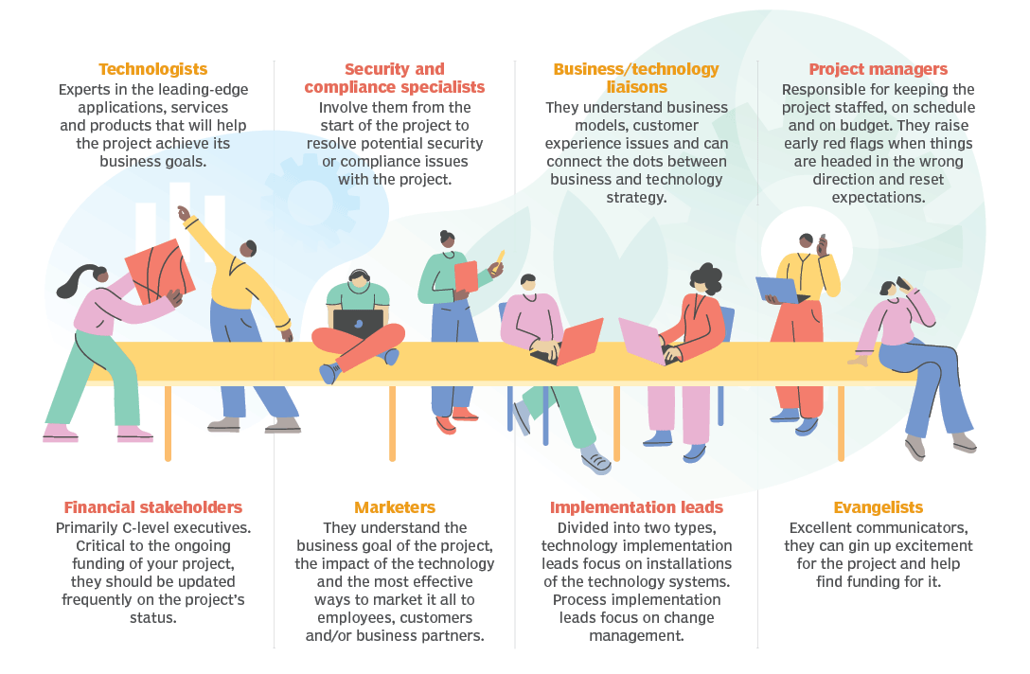
Overcoming the Challenges and Threats
12
2 - Create a Change Leadership Team

Slide 13
Overcoming the Challenges and Threats
13
3 - Hire a Digital Transformation Consultant

Slide 14
Overcoming the Challenges and Threats
14
4 - Align Business Goals with Digital Transformation Strategy

Slide 15
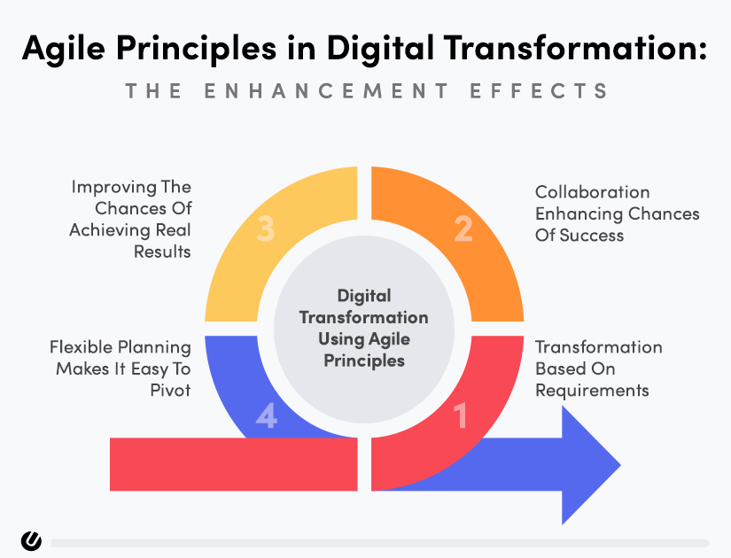
Overcoming the Challenges and Threats
15
5 - Be Agile

Slide 16
Conclusions
16
Successful Digital Transformation is not only about implementing digital technologies. It represents a cultural change that requires a completely new mind-set on a company-wide scale.
Create a Change Leadership Team that will help you implement digital transformation and build an effective business.

